Slide 1
Peer to Peer ChatSDK with distributed hashtables
Masterproject
Benedikt Kaiser

Slide 2
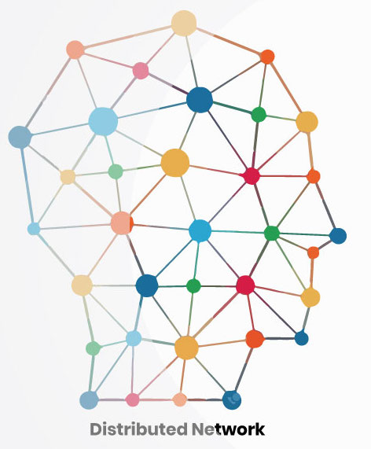
Vision
Distributed internet
Privacy
No more sold data
(web3)
https://www.btcwires.com/glossary/distributed-network/

Slide 3

Product
P2P ChatSDK with distributed hash tables als Masterarbeit
Serverless
ChatSDK for iOS
Notes:
Serverlos, nicht so wie zB bei Matrix, wo man trotzdem daheim noch seinen node benötigt

Slide 4
Master thesis
2nd semestre:
literature research
iOS app for testing the udp connection
3rd semestre:
Implementing distributed hash table
Testing & optimizing
4th semestre:
Evaluation technology
Writing master thesis

Slide 5

Main problems
Person A
Person B

Slide 6
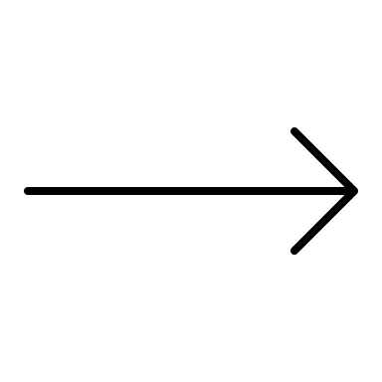

Main problems
Person A
Person B

Slide 7
Main problems
How can person b be reached?
Person A
Person B
IP address
Email address
Telephon nr.

Slide 8
Main problems
How can person b be reached?
Person A
Person B
IP address
Email address
Telephon nr.
How do we get the ip address?

Slide 9

Main problems
Conventional structure
Person A
Server
Person B
Fixed ip

Slide 10
Main problems
Conventional structure
Person A
Server
Person B
Fixed ip

Slide 11
Main problems
Conventional structure
Person A
Server
Person B
Push message (APNs)
Device ID

Slide 12
Main problems
How can person b be reached?
Person A
Person B
IP address
How do we get the ip address?

Slide 13

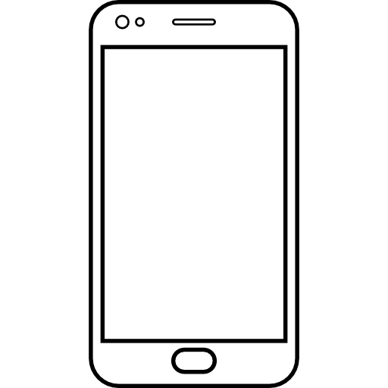
Answer: Distributed hash tables / Kademlia
Data
Key
Benedikt Kaiser
Hash function
FC65B3D
FC65B3D | 10.3.106.97:1337

Slide 14
Answer: Distributed hash tables / Kademlia
Data
Key
Benedikt Kaiser
Hash function
FC65B3D
Tobias Wagner
Hash function
A195CC2
Thomas Sickinger
Hash function
231BCD3

Slide 15
Routing table
FC65B3D | 10.3.106.97:1337
2E5BF1D | 10.3.106.97:1347
37HF21A | 10.3.106.97:1317
New nodes get added
Unresponsive nodes get removed
What happens if the receiver is not in my routing table?

Slide 16
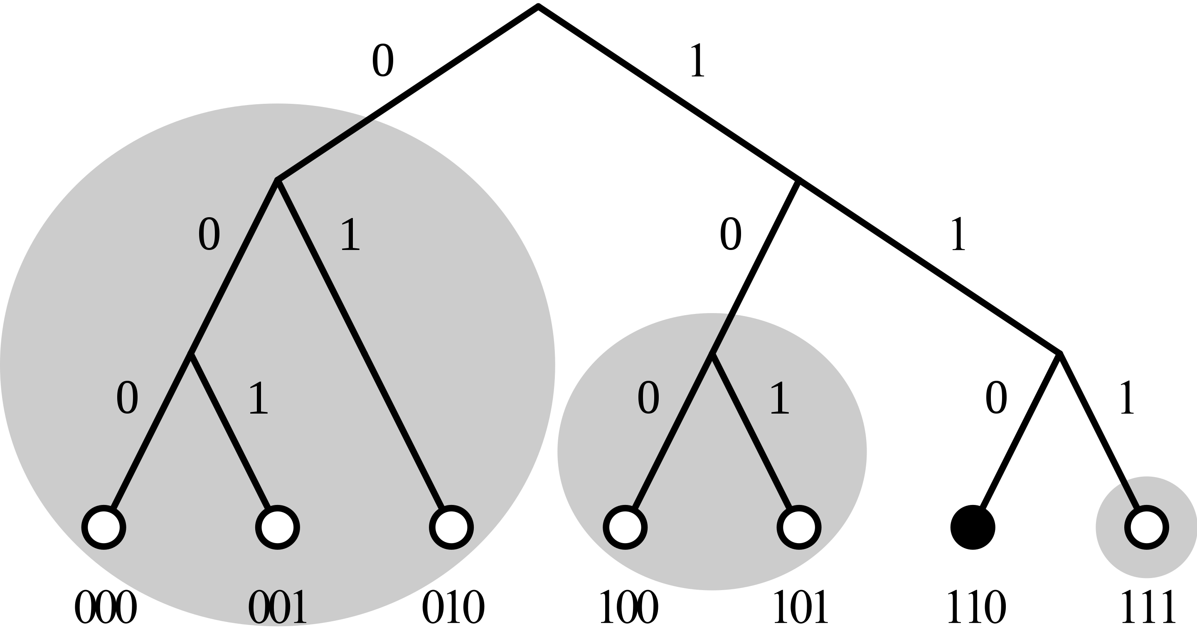
Distance between nodes
How similair are two nodes?
Xor metric
https://en.wikipedia.org/wiki/Kademlia#/media/File:Dht_example_SVG.svg

Slide 17
Joining a network
How do I know the IP-Adress of anyone in a network?
WebRTC’s Perfect Negotiation
Define an interface
Programmer who uses SDK needs to decide

Slide 18
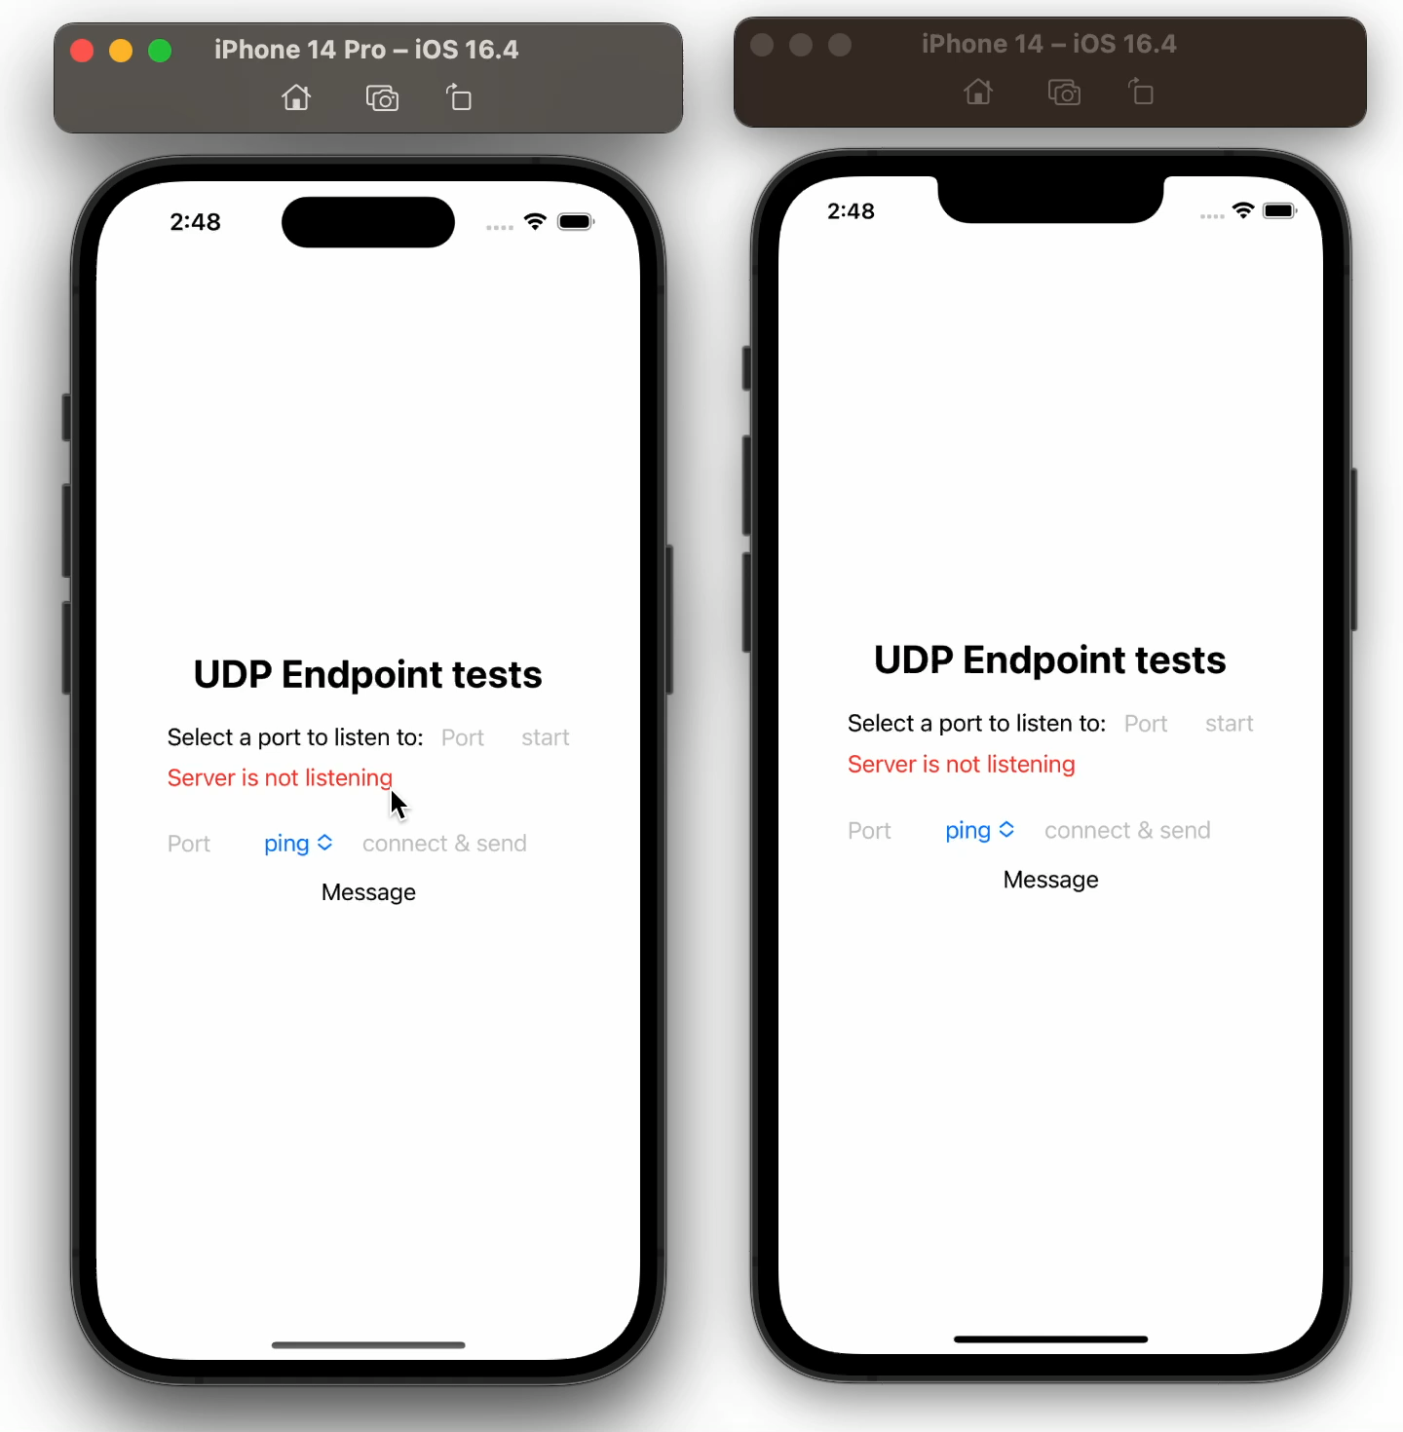
iOS test app
Tests a udp connection

Slide 19


iOS test app - difficulties
UDP socket
Background tasks in iOS

Slide 20
Thanks for the attention

